Slide 1
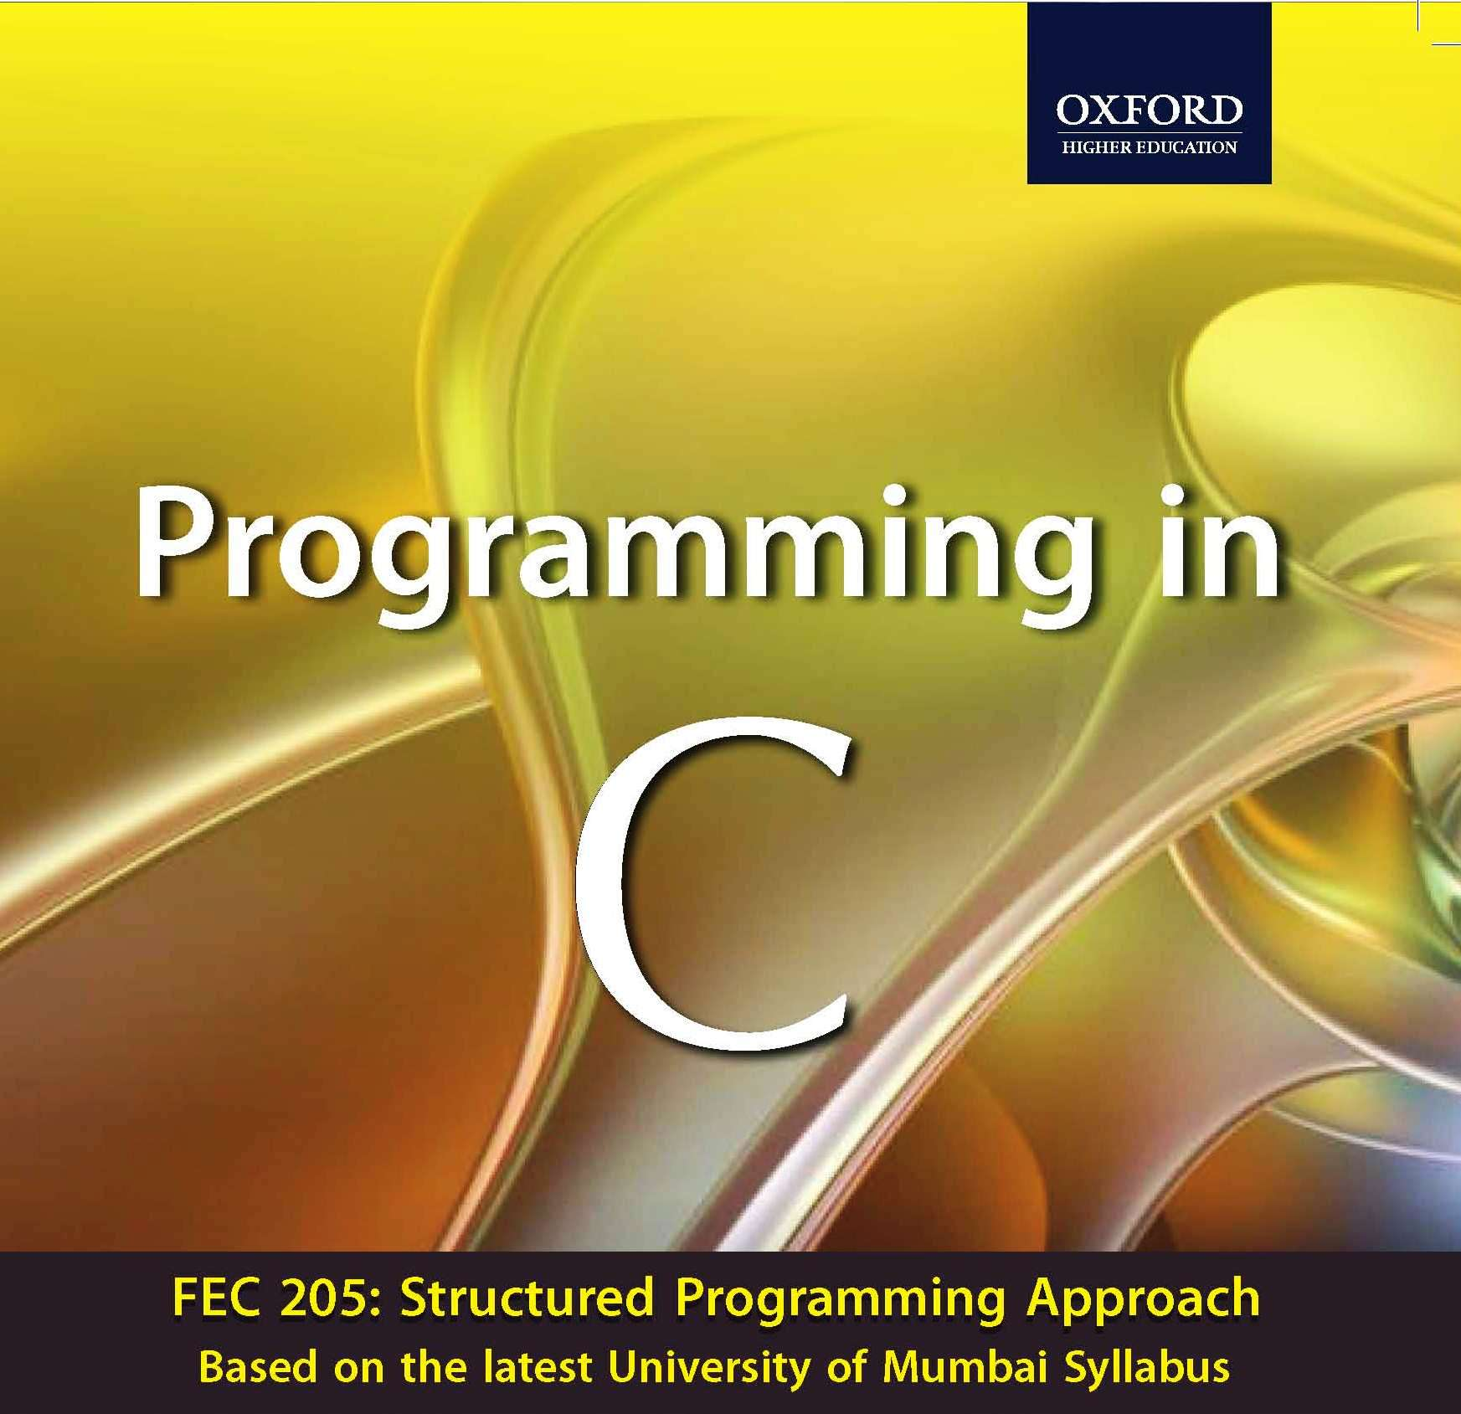


Slide 2

Chapter 6
Functions

Slide 3
INTRODUCTION
During the 1970s and into the 80s, the primary software engineering methodology was structured programming.
Structured programming makes
    programs more comprehensible.
    programming errors less frequent.
A function is a self-contained block of program statements that performs a particular task.

Slide 4
Why are Functions Needed?
It break up a program into easily manageable chunks and makes programs significantly easier to understand.
Well written functions may be reused in multiple programs. eg. The C standard library functions.
Functions can be used to protect data.
Different programmers working on one large project can divide the workload by writing different functions.

Slide 5
All C programs contain at least one function, called main() where execution starts.
When a function is called, the code contained in that function is executed.
When the function has finished executing, control returns to the point at which that function was called.

Slide 6
Function Prototype Declaration
The general form of function declaration statement is as follows:
return_data_type function_name (data_type variable1,...);
Or
return_data_type function_name (data_type_list);

Slide 7
function_name :
    This is the name given to the function
    it follows the same naming rules as that for any valid variable in C.
return_data_type:
    This specifies the type of data given back to the calling construct by the function after it executes its specific task.
data_type_list:
    This list specifies the data type of each of the variables.

Slide 8
The name of a function is global.
No function can be defined in another function body.
Number of arguments must agree with the number of parameters specified in the prototype.
The function return type cannot be an array or a function type.

Slide 9
Rules for parameters
The number of parameters in the actual and formal parameter lists must be consistent.
Parameter association in C is positional.
Actual parameters and formal parameters must be of compatible data types.
Actual (input) parameters may be a variable, constant, or any expression matching the type of the corresponding formal parameter.

Slide 10
CALL BY VALUE MECHANISM
In call by value, a copy of the data is made and the copy is sent to the function.
The copies of the value held by the arguments are passed by the function call.
As only copies of the values held in the arguments are sent to the formal parameters, the function cannot directly modify the arguments passed.

Slide 11
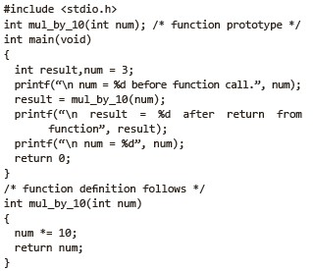

An Example of Call by value mechanism:

Slide 12
PASSING ARRAYS TO FUNCTIONS
When an array is passed to a function, the address of the array is passed and not the copy of the complete array.
During its execution the function has the ability to modify the contents of the array that is specified as the function argument.
The array is not passed to a function by value.
This is an exception to the rule of passing the function arguments by value.

Slide 13
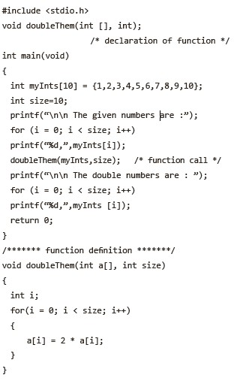

Consider the following example.

Slide 14
Scope Rules
The region of the program over which the declaration of an identifier is accessible is called the scope of the identifier.
The scope relates to the accessibility, the period of existence, and the boundary of usage of variables declared in a program.
Scopes can be of four types.
  Block
  File
  Function
  Function prototype

Slide 15
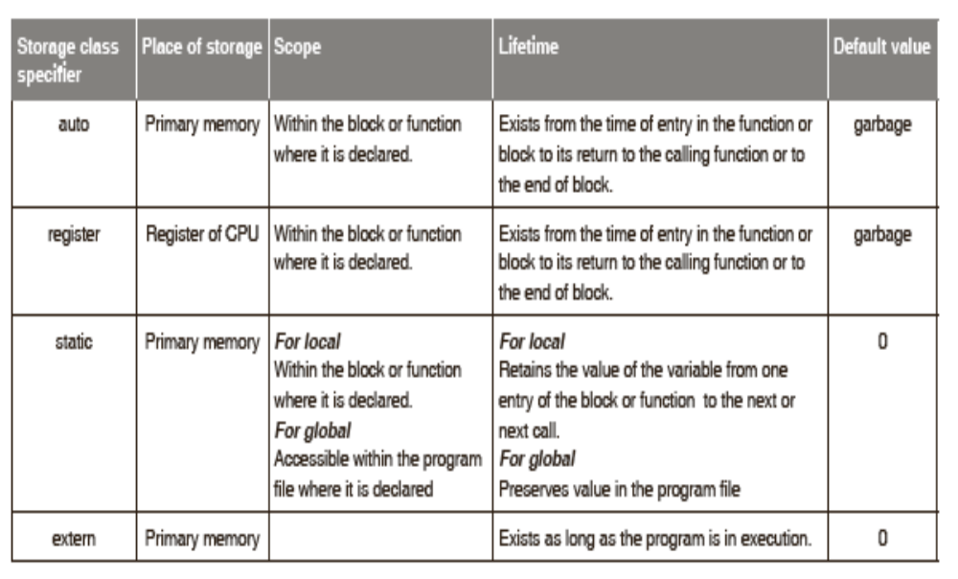
STORAGE CLASSES

Slide 16
Storage Class Specifiers for Functions
The only storage class specifiers that may be assigned with functions are extern and static.
The extern signifies that the function can be referenced from other files.
The static signifies that the function cannot be referenced from other files.
If no storage class appears in a function definition, extern is presumed.

Slide 17
Linkage
An identifier’s linkage determines which of the references to that identifier refer to the same object.
C defines three types of linkages – external, internal and no linkage.
Functions and global variables have external linkage.
Identifiers with file scope declared as static have internal linkage.
Local identifiers have no linkage and are therefore known only within their own block.
The same identifier cannot appear in a fi le with both internal and external linkage.

Slide 18
THE INLINE FUNCTION
C99 has added the keyword inline, which applies to functions.
By preceding a function declaration with inline, the compiler is instructed to optimize calls to the function.
Here the function’s code will be expanded in line, rather than called.
Function definition:
  inline int sum(int x, int y)
  {
  return x+y;
}

Slide 19
RECURSION
Recursion in programming is a technique for defining a problem in terms of one or more smaller versions of the same problem.
A function that calls itself directly or indirectly to solve a smaller version of its task until a final call which does not require a self-call is a recursive function.
The following are necessary for implementing recursion:
    Decomposition into smaller problems of same type.
    Recursive calls must diminish problem size.
    Necessity of base case.
    Base case must be reached.

Slide 20
What is needed for implementing recursion?
Decomposition into smaller problems of same type
Recursive calls must diminish problem size
Necessity of base case
Base case must be reached
It acts as a terminating condition. Without an explicitly defined base case, a recursive function would call itself indefinitely.
It is the building block to the complete solution. In a sense, a recursive function determines its solution from the base case(s) it reaches.

Slide 21
SEARCHING
Among the searching algorithms, only two of them will be discussed here;
  Sequential search
  Binary search.

Slide 22
Sequential Search
Here is an implementation of this simple algorithm:
  int Lsearch(int ArrayElement[], int key, int ArraySize)
  {
int i ;
for (i = 0; i < ArraySize; i++)
if (ArrayElement[i] == Key)
return (i) ;
return (-1);
}

Slide 23
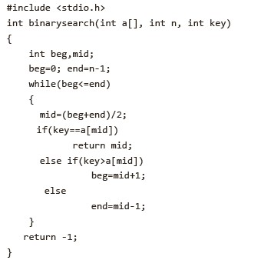
Binary Search
The C code for binary search is given below.

Slide 24
SORTING
Arranging elements of an array in a particular order is called sorting.
Sorting algorithms are divided into two categories:
  Internal sort:
    Any sort algorithm, which uses main memory exclusively during the sort.
    This assumes high-speed random access to all memory.
  External sort:
    Any sort algorithm, which uses external memory, such as tape or disk, during the sort.

Slide 25
Some of the sorting methods include:
  Bubble sort
  Selection sort
  Insertion sort
  Merge sort
  Quick sort

Slide 26
Merge sort
The merge sort splits a data list to be sorted into two equal halves, and places them in separate arrays.
This sorting method uses the divide-and-conquer paradigm.

Slide 27
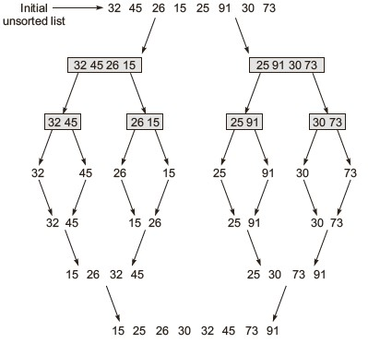


Slide 28
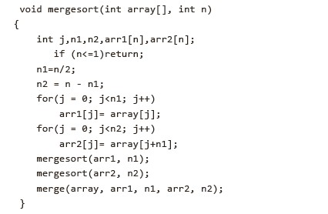
A function that implements the merge sort algorithm discussed above is given as follows:

Slide 29
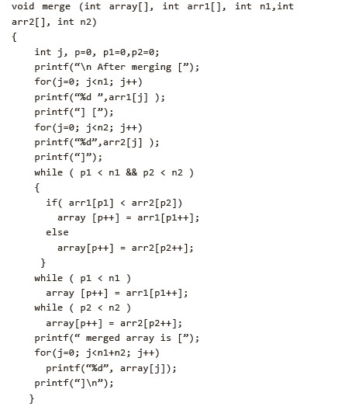

Slide 30
Quick sort
Quick sort is a recursively defined procedure for rearranging the values stored in an array in ascending or descending order.

Slide 31
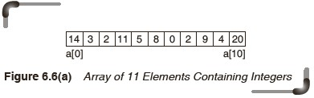
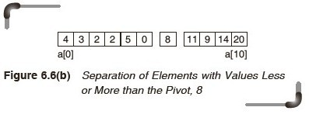

Slide 32
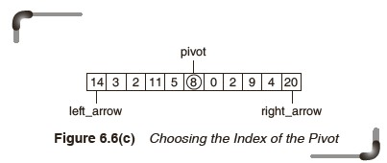
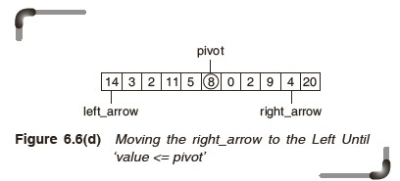

Slide 33
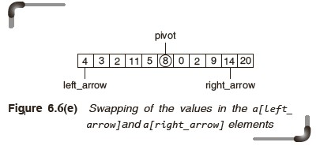
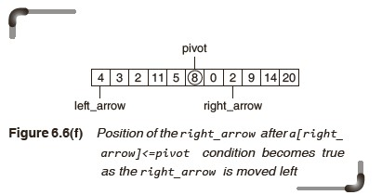

Slide 34
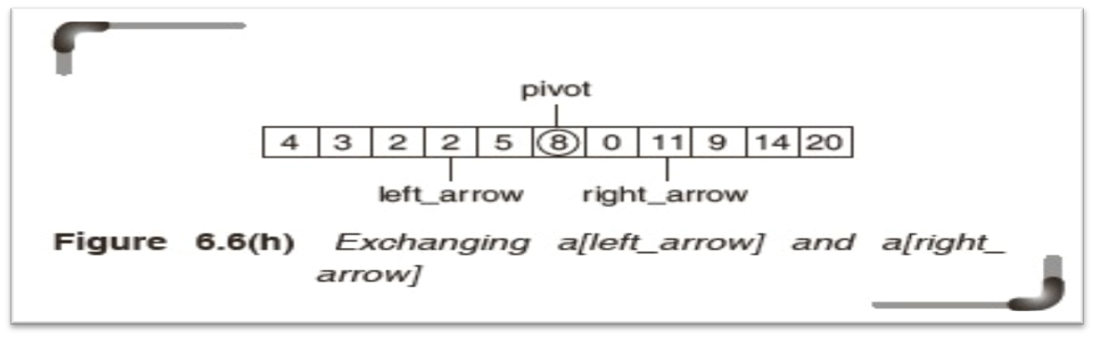
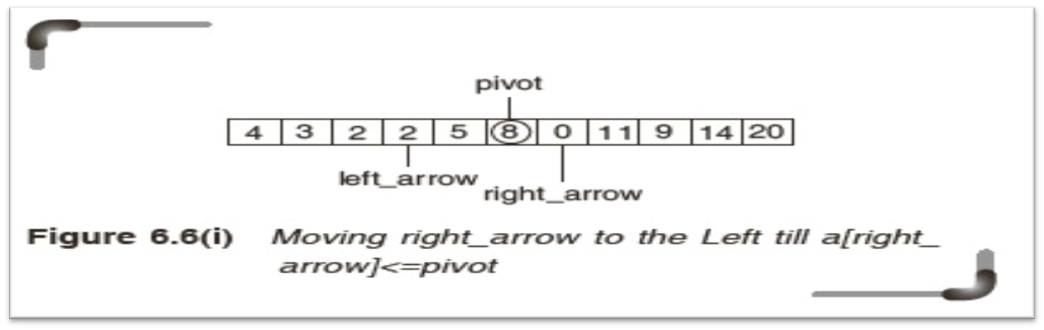
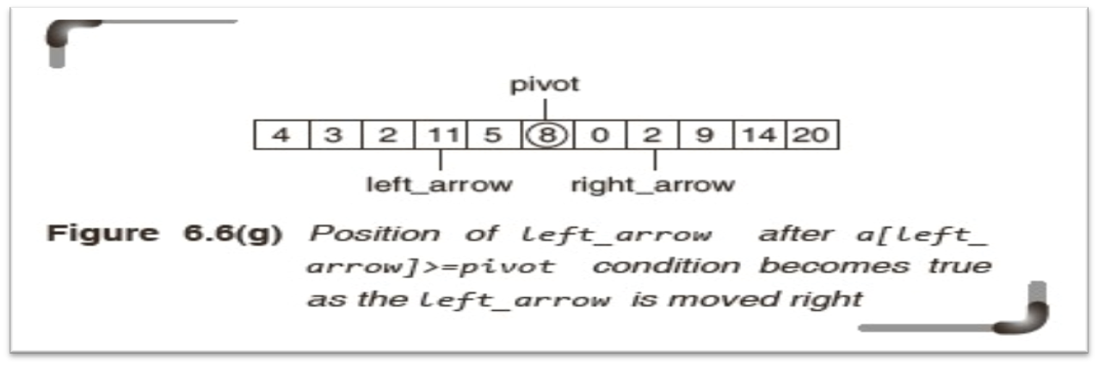

Slide 35
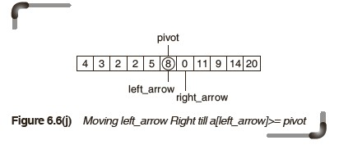
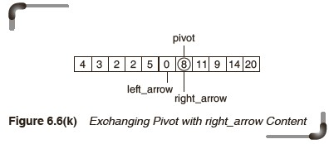

Slide 36
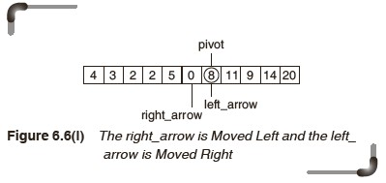
The procedure’s terminating condition left_arrow >right_arrow is now true, and the first sub-division of the list (i.e., array) is now complete.

Slide 37
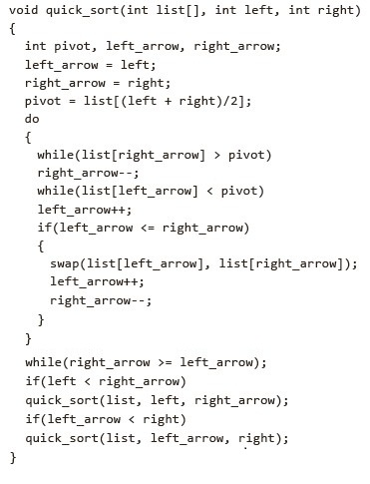
The quick sort procedure is coded as a recursive C function.
This can be seen as follows:

Slide 38
ANALYSIS OF ALGORITHMS
In analyzing an algorithm, rather than a piece of code, the number of times ‘the principle activity’ of that algorithm is performed, should be predicted.
The efficiency of an algorithm is determined by the amount of time it takes to run the program and the memory space the program requires.

Slide 39
COMPLEXITY
Complexity of an algorithm is a measure of the amount of time and/or memory space required by an algorithm for a given input.
It is a function describing the efficiency of the algorithm in terms of the amount of data the algorithm must process.
Usually there are natural units for the domain and range of this function.

Slide 40
The following are the two main complexity measures of the efficiency of an algorithm:
  Time complexity:
    It is a function describing the amount of time an algorithm takes with respect to the amount of input provided to the algorithm
    It is denoted as T(n) where n is the size of the input.
  Space complexity:
    It is a function describing the amount of memory (space) an algorithm takes with respect to the amount of input provided to the algorithm.
    It is denoted as S(n) where n is the size of the input.

Slide 41
worst-case complexity:
  It is defined by the maximum number of steps taken on any instance of input size n.
best-case complexity:
  The best-case complexity of the algorithm is the function defined by the minimum number of steps taken on any instance of input size n.
average-case complexity:
  It is defined by the average number of steps taken on any instance of input size n.

Slide 42

Big-O Notation
It can be defined as, if f(n) and g(n) are functions defined for positive integers then f(n) = O(g(n)) if there exists a ‘c’ such that |f(n)|<=c|g(n)| for all sufficiently large positive integers n.

Slide 43
Properties of the big-O notation
O(k*f(n)) = O(f(n)), therefore, constants can be ignored.
O(f(n)*g(n)) = O(f(n)) * O(g(n)).
O(f(n)/g(n)) = O(f(n)) / O(g(n)).
O(f(n)+g(n)) = Max[O(f(n)), O(g(n))].
The powers of n are ordered according to the exponent nª=O(n^{b}) iff a <= b.
The order of log n is independent of the base taken log_{a}n=O(log_{b}n) for all a, b > 1.

Slide 44
Analysis of Quick Sort
Best case:
  In the best case, a perfect partition is to be set every time.
  If we let T(n) be the running time of quick sorting n elements, then
  T(n) = 2T(n/2) + O(n)
  since partition runs in O(n) time.
  Thus, the Best case running time is T(n)= O(n log n).

Slide 45
Worst case:
  The partition element was always the greatest value of the one remaining to be sorted.
  Total run of partition is
  1+2+3+...+(n-1)
  =(n-1)n/2.
  Thus, the worst case running time is O(n²).

Slide 46
Average case:
  The average case running time. This is certainly difficult to ascertain because one cannot get any sort of partition.
  It is assumed that each possible partition (0 and n-1, 1 and n-2, 2 and n-3, etc.) is equally-likely.
  Average case running time is T(n)= O(n log n).

Slide 47
Disadvantages of Complexity Analysis
Many algorithms are simply too hard to analyze mathematically.
There may not be sufficient information to know what the most important ‘average’ case really is, therefore analysis is impossible.
Big-O analysis only specifies how it grows with the size of the problem, not how efficient it is.
If there are no large amounts of data, algorithm efficiency may not be important.

